Slide 1
South Korea's Economic Growth
A Comparative Analysis of Growth Model Frameworks
Solow · Ramsey–Cass–Koopmans · Overlapping Generations
Post-Korean War to 2025
PWT Data
R & Stata
1953 → Post-war GDP ~$67/capita
1960–95 → 7.1% avg annual growth
2024 → 12th largest economy
Growth & Development | Economics

Slide 2
INTRODUCTION
The Han River Miracle: Setting the Stage
South Korea transformed from one of the world's poorest nations after the 1950–53 Korean War into the world's 12th largest economy by 2024: a trajectory unmatched in modern economic history.
~2%
35,000+
GDP per capita 1953
(~$67 USD)
GDP per capita 2024
(USD)
Research Objectives
7.1%
OECD
Quantify SK's growth using Solow, RCK & OLG models on PWT data
Test convergence, steady-state, and dynamic efficiency properties
Compare frameworks: which best captures the Korean growth story?
Identify structural breaks and turning points (1997 AFC, 2008 GFC)
Avg. annual growth
1960–1995
Member since 1996
High-income economy
PWT 11.0 | World Bank | IMF data used throughout

Slide 3
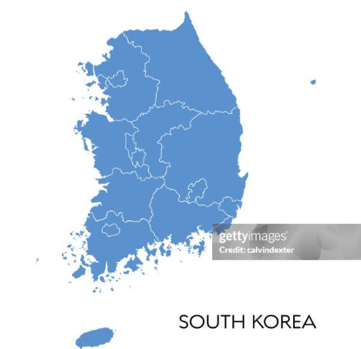
INTRODUCTION
The Han River Miracle: Setting the Stage
35,000+
GD per capita 1953
(~$67 USD)
GDP per capita 2024
(USD)
South Korea transformed from one of the world's poorest nations after the 1950–53 Korean War into the world's 12th largest economy by 2024: a trajectory unmatched in modern economic history.
Young (1995), in his canonical decomposition of East Asian growth for the NBER, attributed most of South Korea's pre-1990 growth to factor accumulation (capital deepening, labour force participation) rather than TFP
This analysis remains true as Korea has continued with technological accumulation and capital growth through the years, achieving a LPR of 64.9% and an impressive GDP of
583,601 billion KRW (2020 base)
7.1%
OECD
Avg. annual growth
1960–1995
Member since 1996
High-income economy

Slide 4


INTRODUCTION
The Han River Miracle: Setting the Stage
35,000+
This reflects the chaebol-led investment boom of the early 1990s — Daewoo, Samsung, Hyundai and LG simultaneously expanding into semiconductors, automobiles, and electronics. Then comes the AFC Krugman argued it was institutional failure. However, its more likely, that it was caused due to unlimited capital inflows
South Korea took significant hits during the AFC which saw large scale capital decumulation. The IMF measures to consolidate banking in the face of adverse selection caused by unclear regulations on guarantees, also opened up the market to Foreign capital inflows
GD per capita 1953
(~$67 USD)
GDP per capita 2024
(USD)
7.1%
OECD
Avg. annual growth
1960–1995
Member since 1996
High-income economy

Slide 5
ECONOMY AT A GLANCE
GDP, Investment, Population & Human Capital
7–9%
38%+
GDP Growth
Investment Rate
Sustained 7–9% growth (1960–1995)
Post-AFC slowdown to ~4–5%
Convergence toward OECD average
Rose from ~10% (1953) to 38%+ (1990s)
Consistently among world's highest
Sharp dip post-1997; recovery by 2002
Demographics
Human Capital
0.4%
>70%
Rapid labour force growth 1960s–80s
Demographic transition from 1990s
Ageing population — key OLG driver
HDI jumped from low to very high
Tertiary enrolment >70% by 2000s
TFP contribution rose post-1990s

Slide 6
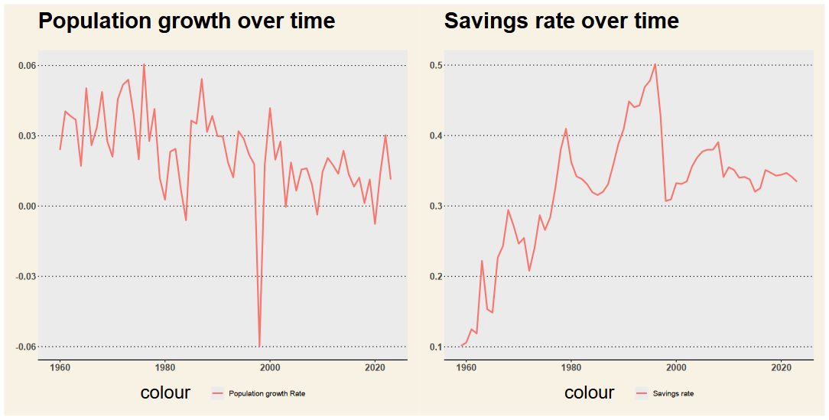
ECONOMY AT A GLANCE
Savings and Population Growth Rates Over Time

Slide 7




METHODOLOGY
Data & Estimation Strategy
Data Source
Models Used
Penn World Tables (PWT 10.0)
World Bank Development Indicators
1953–2024 annual observations
k/worker, y/worker, r, n, g, δ
Solow: OLS growth regressions
Barro: conditional & unconditional
RCK: calibrated phase diagram
OLG: transition function (OLS)
Evaluation
Software
Convergence & Steady state
Dynamic Efficiency(r ≥ n + g)
Model Fit with Data
R (ggplot2, dplyr, lm)
Stata 17 (regress, twoway)
PWT data package in R
Log-linear specifications
Golden Rule condition: r = n + g | Dynamic efficiency: r ≥ n + g

Slide 8
01
Solow Growth Model
Capital Accumulation & Convergence — South Korea
Core framework: Cobb-Douglas, capital accumulation
Phase diagram & steady-state convergence paths
Barro regressions: conditional & unconditional
Actual vs model-fitted output & HDI regression

Slide 9
SOLOW MODEL — THEORY
Solow Model: Core Framework
The Solow (1956) model explains long-run growth via capital accumulation, labour growth and exogenous technological progress. The economy converges to a unique steady state determined by savings, depreciation and population growth.
South Korea Lens
High s ≈ 30–38% drove rapid k* ascent
n declined from ~3% to ~0.4%
α estimated ~0.35–0.40 for SK
Conditional convergence confirmed vs OECD
TFP residual large pre-1990s
Key Equations
Y = K^α (AL)^(1−α) [Cobb-Douglas production]
k̇ = s·f(k) − (n+g+δ)·k [Capital accumulation]
k* = [s / (n+g+δ)]^(1/(1−α)) [Steady-state capital]
Convergence: β = −(1−α)(n+g+δ) [Speed]

Slide 10
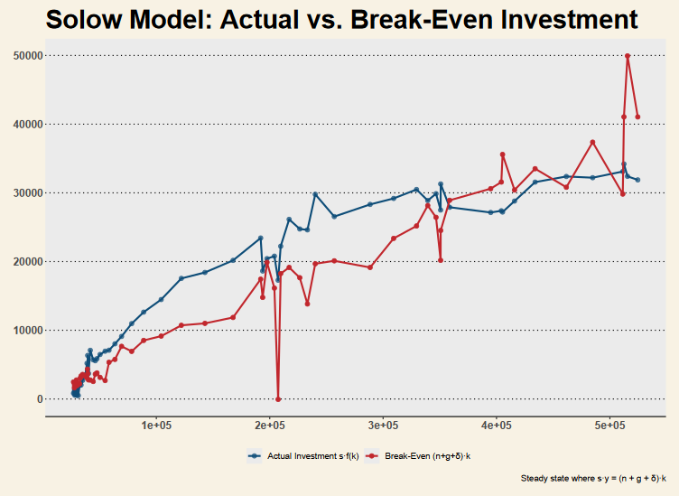
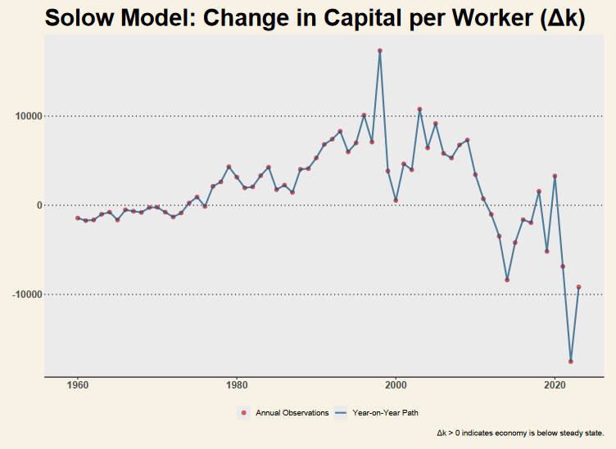
SOLOW — RESULTS
Solow Phase Diagram & Steady-State Paths
Phase diagram: k* convergence with SK savings rate
Time path: simulated capital & output convergence

Slide 11
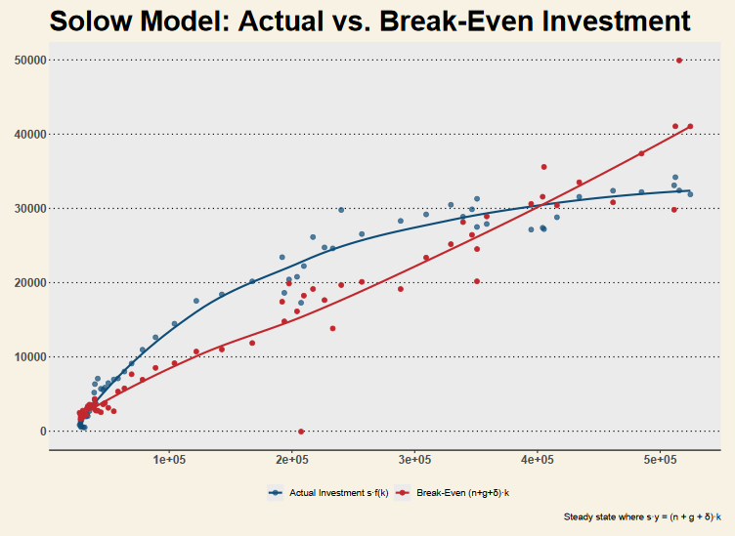
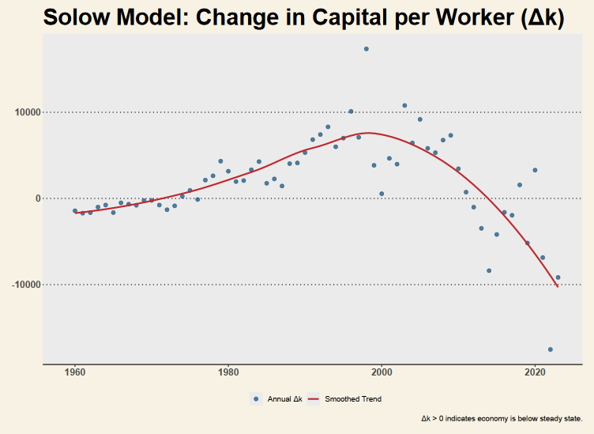
SOLOW — RESULTS
Solow Phase Diagram & Steady-State Paths (Smooth)
Phase diagram: k* convergence with SK savings rate (smoothened)
Time path: simulated capital & output convergence (smoothened)

Slide 12
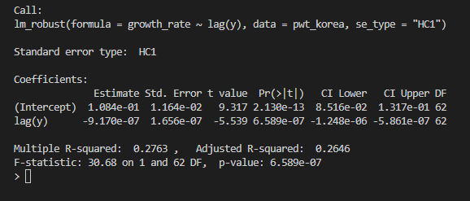
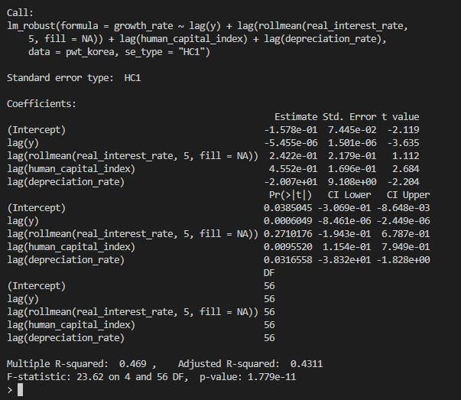
RESULTS
Barro Regressions: Unconditional & Conditional Convergence
Unconditional regression shows text book convergence
Conditional regression clearly explains more of the variation in growth rate than conditional.
However, this cannot be considered a traditional barro reg. as it’s not using cross-sectional data.

Slide 13
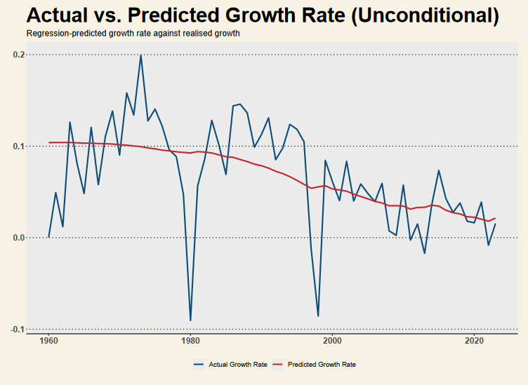
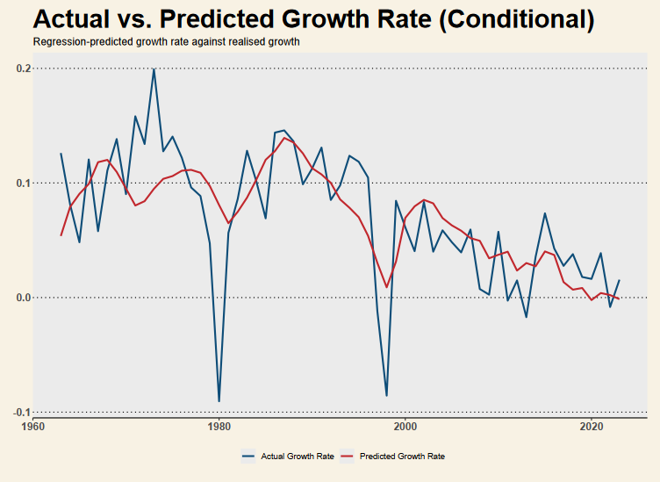
SOLOW — RESULTS
Barro Regressions: Unconditional & Conditional Convergence
SK sits above the unconditional convergence line — confirming high steady-state income relative to initial conditions. Conditional convergence (controlling for investment, human capital) shows SK's fast β-convergence is consistent with the augmented Solow model.

Slide 14
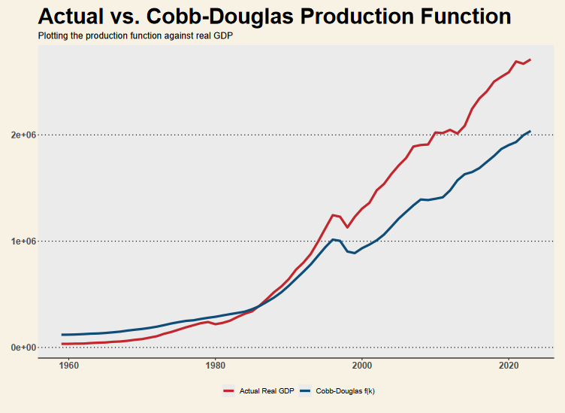
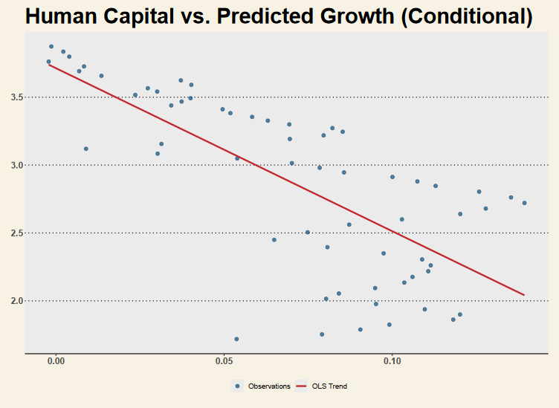
SOLOW — RESULTS
Actual vs Model-Fitted Output & HDI Regression
Key finding: Cobb-Douglas model tracks actual SK output well up to ~1995; the persistent residual thereafter reflects TFP acceleration and structural transformation beyond the basic Solow framework.

Slide 15
02
Ramsey–Cass–Koopmans Model
Optimal Consumption & Intertemporal Choice — South Korea
Euler equation & optimal consumption theory
RCK phase diagram & saddle path derivation
Time dynamics: capital & consumption paths
Real vs RCK-simulated output comparison

Slide 16


RCK: A Theory Overview with respect to South Korea
Inter-Temporal Choices
Capital Accumulation
Household saving rate rose from ~10% (1960s) → 30–40% (1980s–90s)
Among the highest saving rates globally during high-growth phase
Extremely high private spending on education (hagwons culture)
$\dot{k}=f\left(k\right)−c−\left(n+g+δ\right)k$
Investment rate reached ~30–35% of GDP
Government launched Five-Year Economic Plans (1962 onwards)
Rise of Samsung, Hyundai, LG led South Korea to become :Top global shipbuilder and Leading semiconductor exporter
Consumption Dynamics
Dynamic Efficiency
Inter-Temporal Choices
$\frac{\dot{c}}{c}=\frac{1}{θ}\left(r−ρ\right)$
Household consumption share: Fell during high-saving phase
Increased steadily after 1990s
Rapid rise in: Car ownership and Smartphone penetration (led by Samsung)
r > n + g
Real interest rate historically above growth rate
No prolonged periods of over-accumulation
Investments focused on: Export sectors, High productivity industries

Slide 17
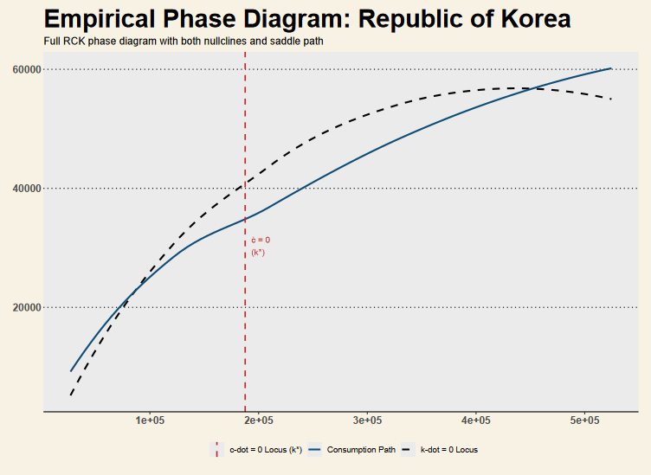
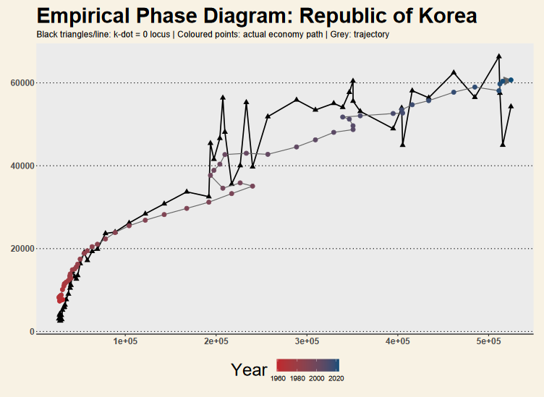
RCK — RESULTS
RCK Phase Diagram & Saddle Path
Left: (k,c) phase plane with ċ=0 and k̇=0 loci; steady-state at their intersection. Right: saddle path — SK's adjustment trajectory to (k*, c*) reflects rapid capital deepening with consumption rising along the optimal path.

Slide 18
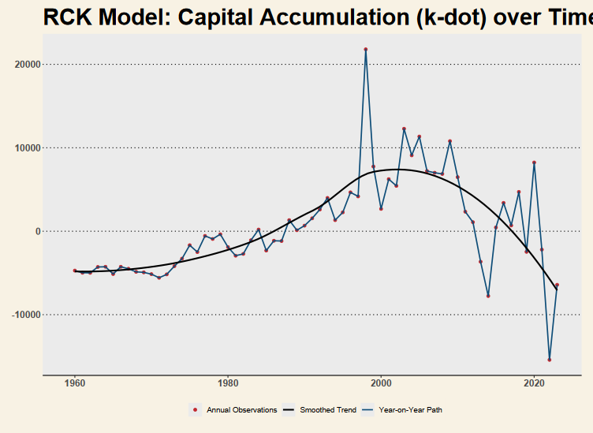
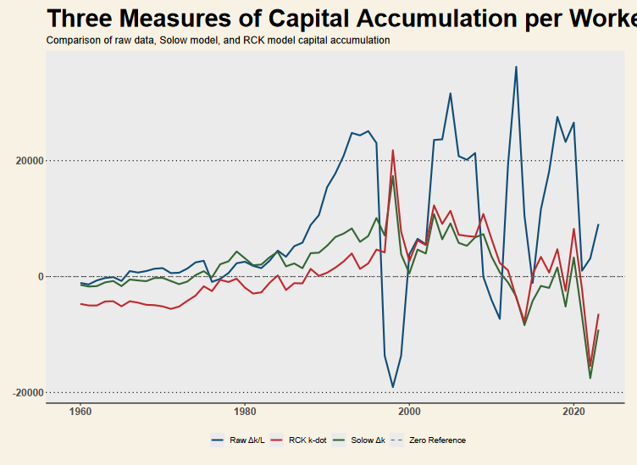
RCK — RESULTS
RCK Time Dynamics & Real vs Simulated Output
RCK fits SK output better than the basic Solow post-1990s — the endogenous savings rate captures the declining investment share more naturally. Both models understate the 1965–1990 growth burst, pointing to structural/policy-driven TFP.

Slide 19
03
Overlapping Generations Model
Demographic Dynamics & Dynamic Efficiency — South Korea
Diamond OLG model: cohorts, wages & savings
Dynamic efficiency: Golden Rule r = n + g
OLG transition function & phase diagram
SK demographic dividend & ageing implications

Slide 20
OLG MODEL — THEORY
OLG: Demographics & Capital Dynamics
The Diamond (1965) OLG model replaces the representative household with two-period lived cohorts — the young save, the old dissave. This creates a rich structure to analyse demographic transitions, pension systems, and dynamic efficiency.
Key Mechanics
Dynamic Efficiency (Golden Rule)
South Korea OLG Lens
k(t+1) = s(w(t)) / (1+n) [Capital transition]
w = f(k) − k·f′(k) [Wage = young income]
r = f′(k) [Return on capital]
Steady state: k(t+1) = k(t)
Golden Rule: r* = n + g
r > n+g → dynamically efficient
r < n+g → over-accumulation (inefficient)
Government can improve welfare by reducing k
Demographic dividend: high n in 1960s–80s
Rapid ageing post-1990s shifts saving behaviour
k(t+1) = [(1−δ)k + i] / (1+n) used for transition.

Slide 21
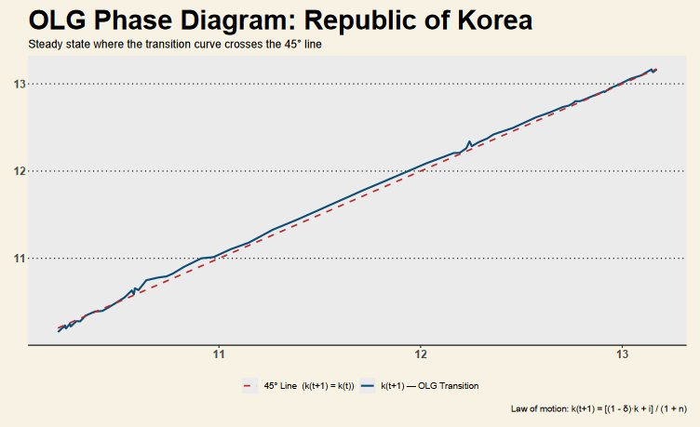
OLG — RESULTS
OLG Phase Diagram
Reading the Chart
Blue Line: OLG Transition Curve (Next generation's capital)
Red Line: 45° Reference Line (Steady state benchmark)
The Golden Era: Blue > Red indicates rapid capital accumulation. Each generation saved enough to equip the next with even more capital.
The Upward Climb: Shows 60+ years of uninterrupted economic growth and industrialization.
The Convergence: At the top right, the blue line finally merges with the red line, signaling the modern era.
Empirical Confirmation of the OLG Model: High savings rates and a demographic dividend pushed South Korea's transition curve above the 45° line for decades, driving the "Miracle on the Han River." The recent convergence at the top right confirms that South Korea has officially reached its macroeconomic steady state, marking the end of its hyper-growth catching-up phase.

Slide 22
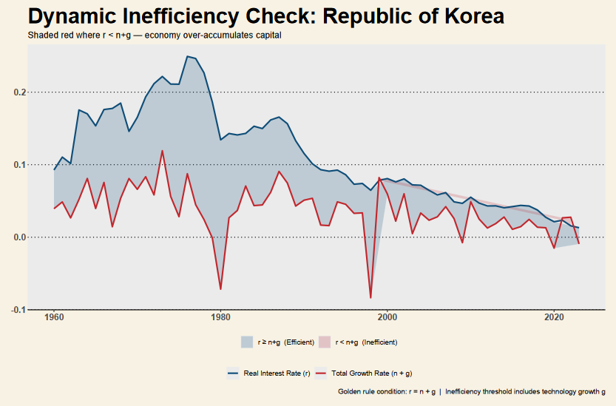
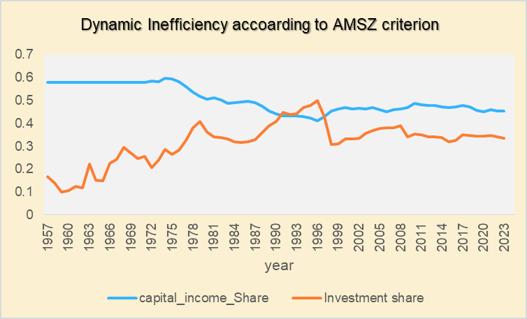
OLG — RESULTS
Dynamic Efficiency Check: South Korea
Reading the Chart
Reading the Chart
Blue: real interest rate r
Red: total growth n+g
Grey shading: r ≥ n+g (efficient)
r > n+g throughout: SK is dynamically efficient
No over-accumulation of capital
1997 AFC: brief near-threshold dip
Post-2010: gap narrowing as r falls
Current: Efficient, but the margin is narrowing
Blue: Capital Income | Orange: Investment
The Rule: Efficient when Blue > Orange
Historical Norm: Consistently dynamically efficient
1990–1997 Anomaly: Inefficient (Orange > Blue) due to massive over-investment
1997 AFC: Crisis destroyed excess capital, restoring efficiency
Current: Efficient, but the margin is narrowing

Slide 23
04
Comparative Analysis
Solow vs RCK vs OLG — Which Model Fits Best?
Model-fit comparison: Solow vs RCK vs OLG
Capital & output steady-state convergence
Which framework best captures SK’s miracle?

Slide 24
COMPARATIVE ANALYSIS
Model Comparison: Fit, Assumptions & Insights
Criterion | Solow | RCK | OLG
Savings rate | Exogenous (s fixed) | Endogenous (Euler eq.) | Endogenous (lifecycle)
Convergence | Conditional β-conv. | Saddle path to k* | Transition fn. (β₁≈1)
Demographics | n in steady state | n in Euler / BC | Core — cohort overlap
Dyn. Efficiency | Not addressed | Efficient by construction | r > n+g → efficient
SK fit (1960–95) | ★★★☆ (TFP gap) | ★★★☆ (better c path) | ★★★★ (demographic)
SK fit (post-97) | ★★☆☆ | ★★★★ | ★★★★
Policy insights | Limited | Consumption smoothing | Pension/SS implications

Slide 25
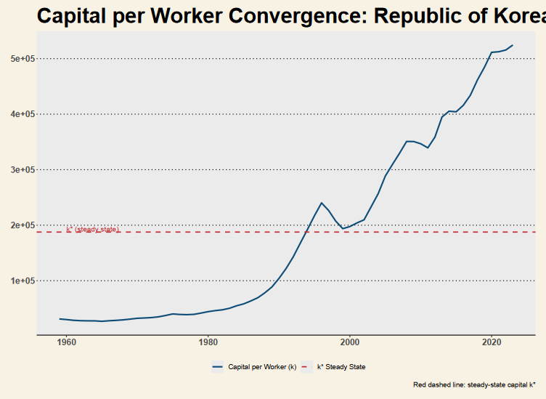
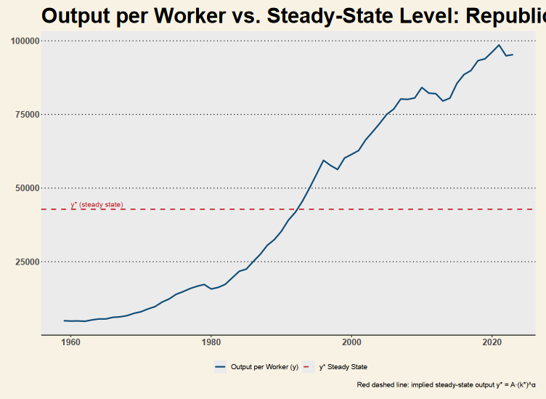
COMPARATIVE — RESULTS
Capital & Output Steady-State Comparisons
Both Solow and RCK converge to similar k* and y* under comparable parametrisation. The RCK steady-state capital stock is lower — reflecting the endogenous saving margin — more consistent with observed post-2000 investment rates.

Slide 26
CONCLUSIONS
Limitations & Conclusions
Solow Takeaways
RCK Takeaways
Confirms conditional convergence for SK
High s drove rapid k* ascent (1960–1990)
TFP residual unexplained — needs augmentation
Endogenous s better fits post-1997 profile
Saddle path replicates consumption smoothing
Welfare-optimal path differs from observed
OLG Takeaways
Model Limitations
SK dynamically efficient (r > n+g throughout)
β₁ ≈ 1 signals proximity to steady state
Ageing will pressure future capital accumulation
All models abstract from institutions & policy
No open-economy dynamics (SK is trade-dependent)
Structural breaks (1997, 2008) not endogenised
★ Key Finding: South Korea is dynamically efficient throughout — RCK & OLG together best explain the post-1990 growth trajectory ★

Slide 27
CONCLUSIONS
Citations
Young, A. (1995). The Tyranny of Numbers: Confronting the Statistical Realities of the East Asian Growth Experience. The Quarterly Journal of Economics, 110(3), 641–680. https://doi.org/10.2307/2946695
Mankiw, N. G., Romer, D., & Weil, D. N. (1992). A contribution to the empirics of economic growth. The Quarterly Journal of Economics, 107(2), 407–437. https://doi.org/10.2307/2118477
Temple, J., & Johnson, P. A. (1998). Social Capability and Economic Growth. The Quarterly Journal of Economics, 113(3), 965–990. http://www.jstor.org/stable/2586879
Calvo, G. A. (1998). Capital flows and capital-market crises: The simpleeconomics of sudden stops. Journal of Applied Economics, 1(1), 35-54. https://ucema.edu.ar/publicaciones/download/volume1/calvo.pdf
★ Documents sourced via JSTOR, Science direct and various university publications ★

Slide 28
Thank You!
South Korea's Economic Growth: Solow, RCK & OLG Comparative Analysis
Growth & Development

